Slide 2

CRISPR Annotation Tool for Parsing In Silco Sequences
C
A
T
P
I
S
S
litterbox Productions
Hunter, Mina, John, Doug, Becky, Zach, and Matt

Slide 3
CRISPR – precise targeting to edit the genome or alter expression

Slide 4
Designing gRNAs for species with annotated guide sites

Slide 5
CATPISS v1.0 – with annotated gRNAs (human/mouse)
User input: organism name, gene list, CRISPRi/a or custom range, cloning strategy
Annotation file (GFF3)
(Ensembl)
Annotated gRNAs
(download from UCSC)
CRISPRi/a or
Custom Range around TSS
Gene List
TSS Table
gRNAs/Scores + Location
Top scored gRNAs for each gene ready for cloning

Slide 6
Designing gRNAs for species without annotated guide sites

Slide 7
CATPISS v1.0 – gRNAs for any organism
User input: gene list, CRISPRi/a or custom, cloning strategy, fasta, Cas info, options for gRNA scoring, TSS table
Find all gRNAs and scores them based on off-targets
(Input: Fasta, Cas protein, additional parameters)
Table of genes and TSS
(user produced if not publicly available)
CRISPRi or a
Custom Range around TSS
bed file; Keep for next time
Gene List
TSS Table
gRNAs/Scores + Location
Top scored gRNAs for each gene ready for cloning

Slide 8
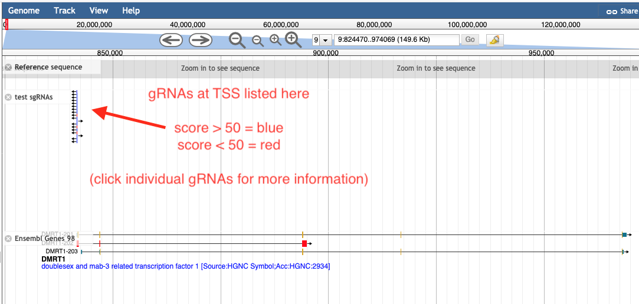
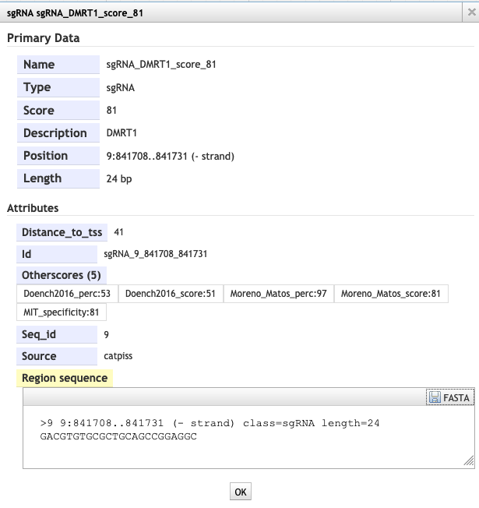
Visualizing gRNAs in JBrowse

